Slide 1

Resting-State fMRI: Algorithms, Applications to Brain Disorders and Data Processing
Chao-Gan YAN, Ph.D.
严超赣
ycg.yan@gmail.com
http://rfmri.org
Nathan Kline Institute, Child Mind Institute and
Child Study Center, New York University
1

Slide 2
Outline
Resting-State fMRI: Principles
Computational Algorithms
Methodological Issues
Applications to Brain Disorders
Introduction to DPARSF
2

Slide 3
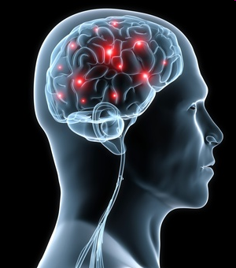
Resting-State fMRI: Principles
All of the human high mental functions such as thinking, emotion and consciousness rely on brain, an extremely complex system (Singer, 1999)
http://psychcentral.com/news/2010/11/03/new-insights-on-brains-internal-wiring/20500.html
3

Slide 4
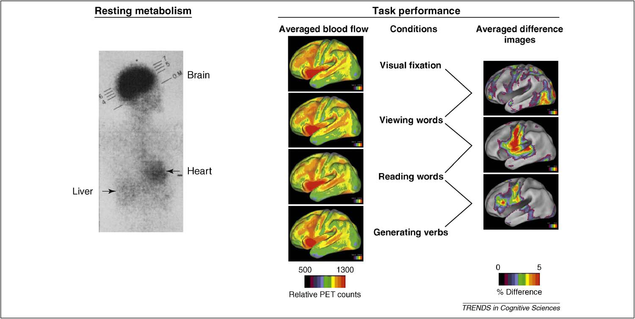
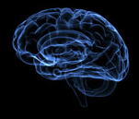
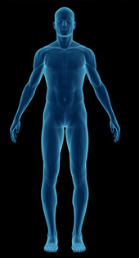
Resting-State fMRI: Principles
Weight
Cardiac output
Glucose consumption
2%
11%
20%
Raichle et al., 2010. Trends Cogn Sci
4

Slide 5
Resting-State fMRI: Principles
Task evoked increases
Resting-state energy consumption
<5%
There are very important activities in the brain during resting-state (Fox and Raichle, 2007; Zhang and Raichle, 2010)
Raichle et al., 2010. Trends Cogn Sci
5

Slide 6
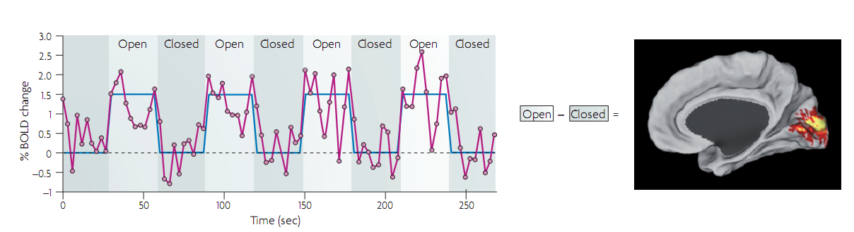
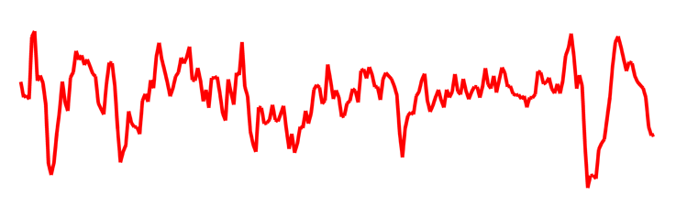
Resting-State fMRI: Principles
Task
Traditional fMRI analysis
Baseline
Noise?
Activities in the baseline state (usually resting-state)
Fox and Raichle, 2007. Nat Rev Neurosci
6

Slide 7
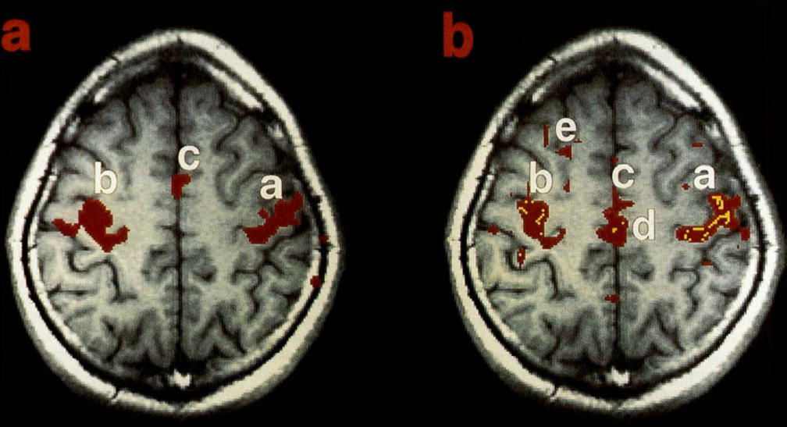
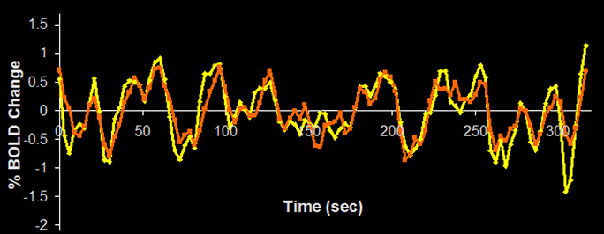
Resting-State fMRI: Principles
Temporal synchrony of spontaneous fluctuations
Task: left and right finger movement
Resting-state
Biswal et al., 1995. Magn Reson Med
7

Slide 8
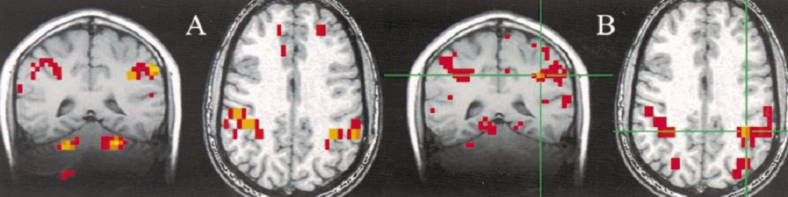
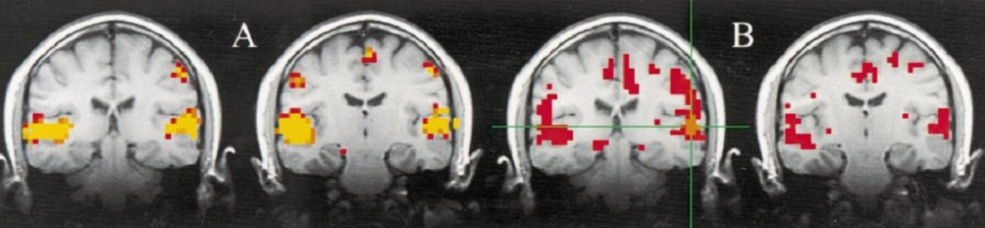
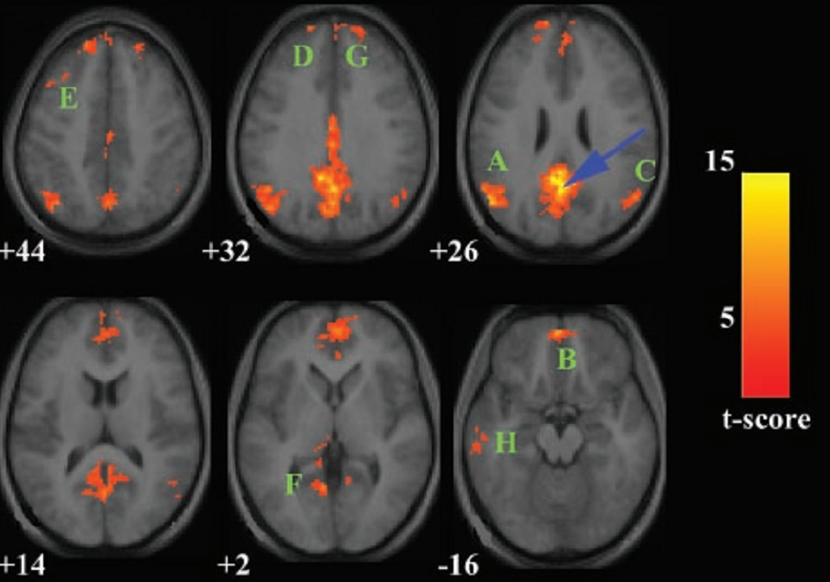
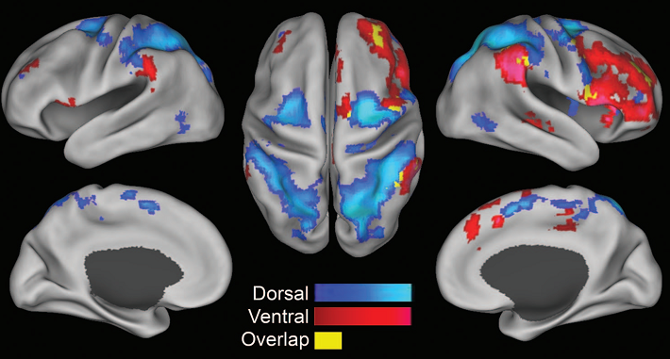
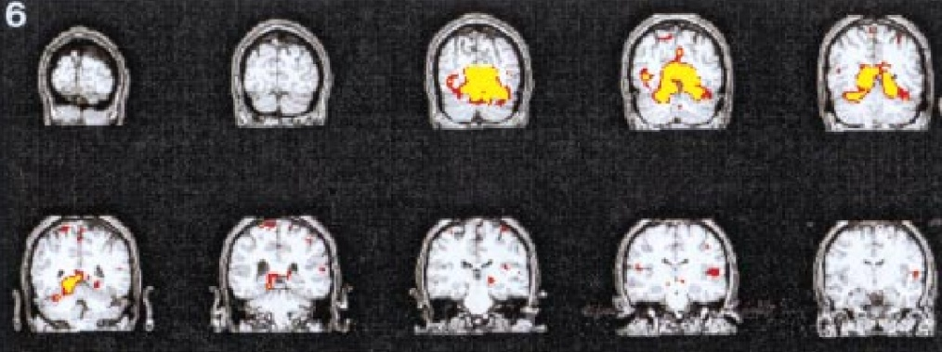
Resting-State fMRI: Principles
Functional networks identified by functional connectivity with resting-state fMRI (RS-fMRI)
Sensorimotor network (Cordes et al., 2000. AJNR)
Auditory network (Cordes et al., 2000. AJNR)
Visual network (Lowe et al., 1998. Neuroimage)
Attentional network (Fox et al., 2006. PNAS)
DMN (Greicius et al., 2003. PNAS)
8

Slide 9
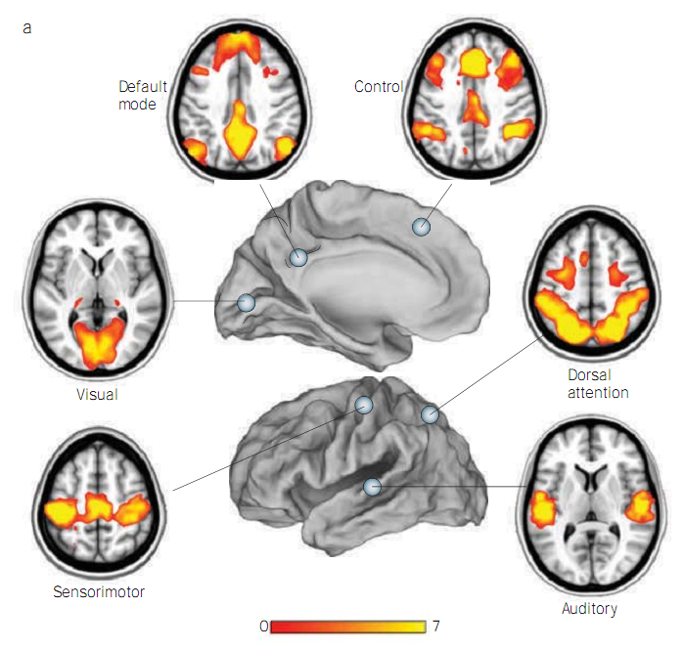
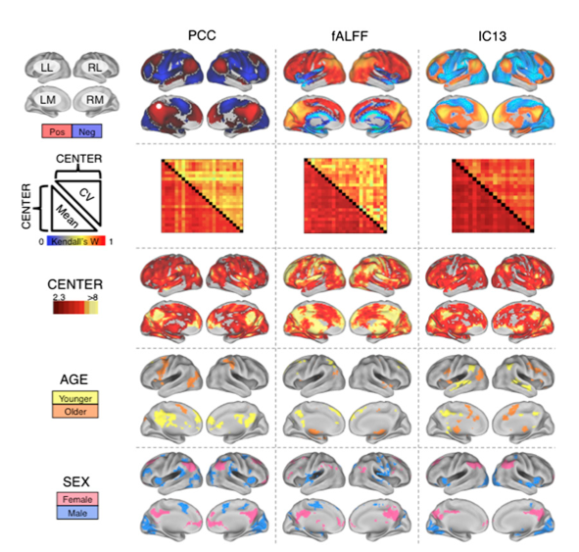
Resting-State fMRI: Principles
Zhang and Raichle, 2010. Nat Rev Neurol
Biswal et al., 2010. PNAS
9

Slide 10
Outline
Resting-State fMRI: Principles
Computational Algorithms
Methodological Issues
Applications to Brain Disorders
Introduction to DPARSF
10

Slide 11

Computational Methodology
Integration approach
Regional approach
Graphical approach
Personal understanding of grouping

Slide 12
Computational Methodology
Integration approach
Functional Connectivity
Correlation: (Biswal et al., 1995; ……)
ICA: (Kiviniemi et al., 2003; van de Ven et al., 2004; Greicius et al., 2004)
Effective Connectivity: (Friston et al., 2002)
Hierarchical Clustering: (Cordes et al., 2000; Salvador et al., 2005)
Self Organization Map: (Peltier et al., 2003)
....

Slide 13
Computational Methodology
Correlation: Temporal synchrony of spontaneous fluctuations
Task: left and right finger movement
Resting-state
Biswal et al., 1995. Magn Reson Med
13

Slide 14

Computational Methodology
The “Resting” Brain
Courtesy of Dr. Daniel Margulies

Slide 15
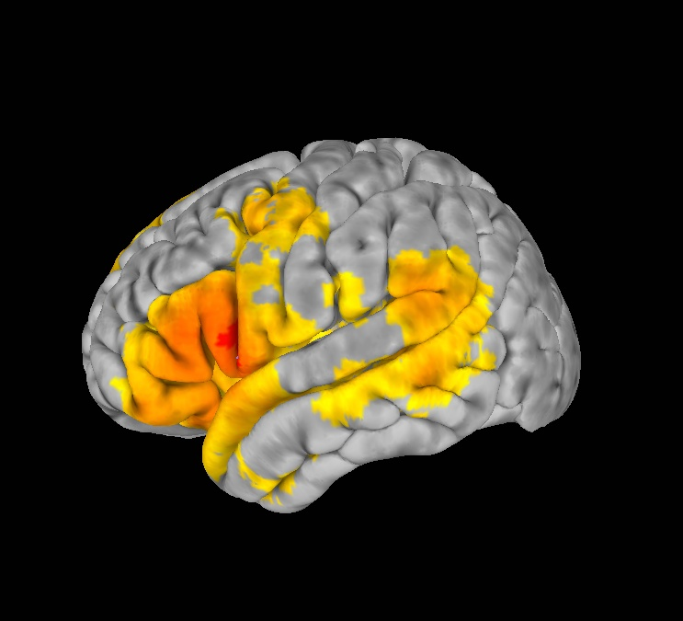
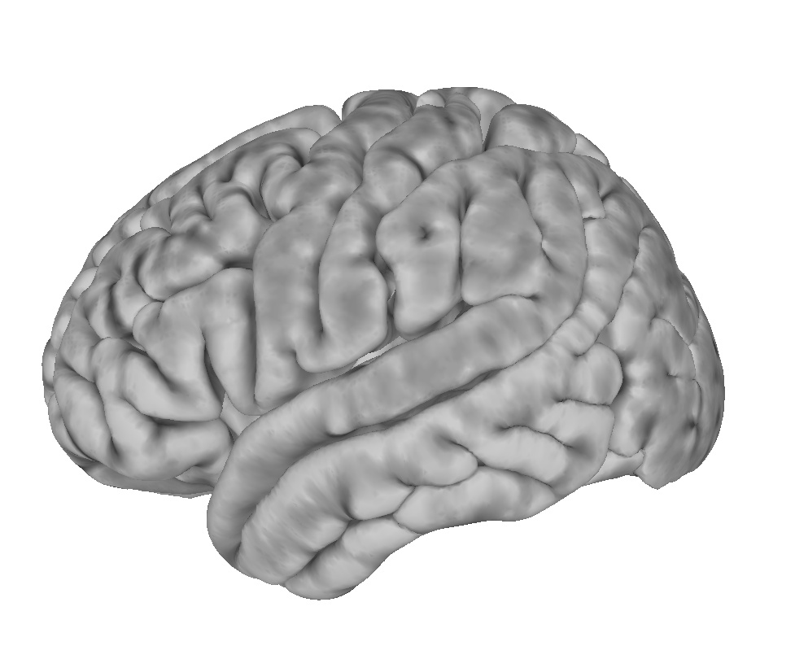
Computational Methodology
How do we detect organized patterns of intrinsic activity?
Resting State Functional Connectivity
Correlate
Notes:
How do we measure this organization?

Slide 16
Computational Methodology
Correlation
Zhang and Raichle, 2010. Nat Rev Neurol
16

Slide 17
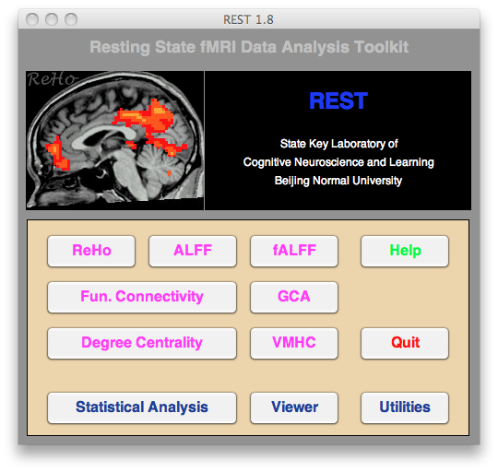
Computational Methodology
Correlation
REST 1.0 – 1.1: SONG Xiao-Wei
REST 1.2 – 1.8: YAN Chao-Gan, DONG Zhang-Ye, ZANG Zhen-Xiang, WANG Xin-Di.
Song, , Yan, Zang, 2011. PLoS ONE
17

Slide 18
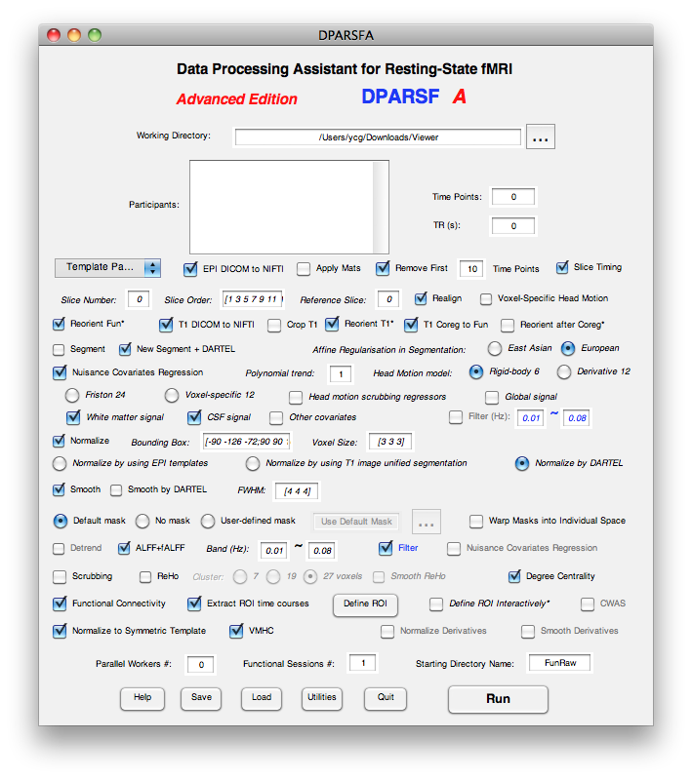
Computational Methodology
Correlation
Yan and Zang, 2010.
Front Syst Neurosci
http://rfmri.org/DPARSF
18

Slide 19
Computational Methodology
Directionality
Association
(undirected network)
Directionality
Causality
(directed network)
19

Slide 20
Computational Methodology
Directionality
Statistical techniques
Structural Equation Modeling (McIntosh and Gonzalez-Lima, 1994)
Dynamic Causal Modeling (Friston et al., 2003)
Granger causality analysis (GCA) (Granger, 1969; Goebel et al., 2003)
....
Lesion studies
Brain stimulation
Craddock, , Yan et al., 2013. Nat Methods

Slide 21
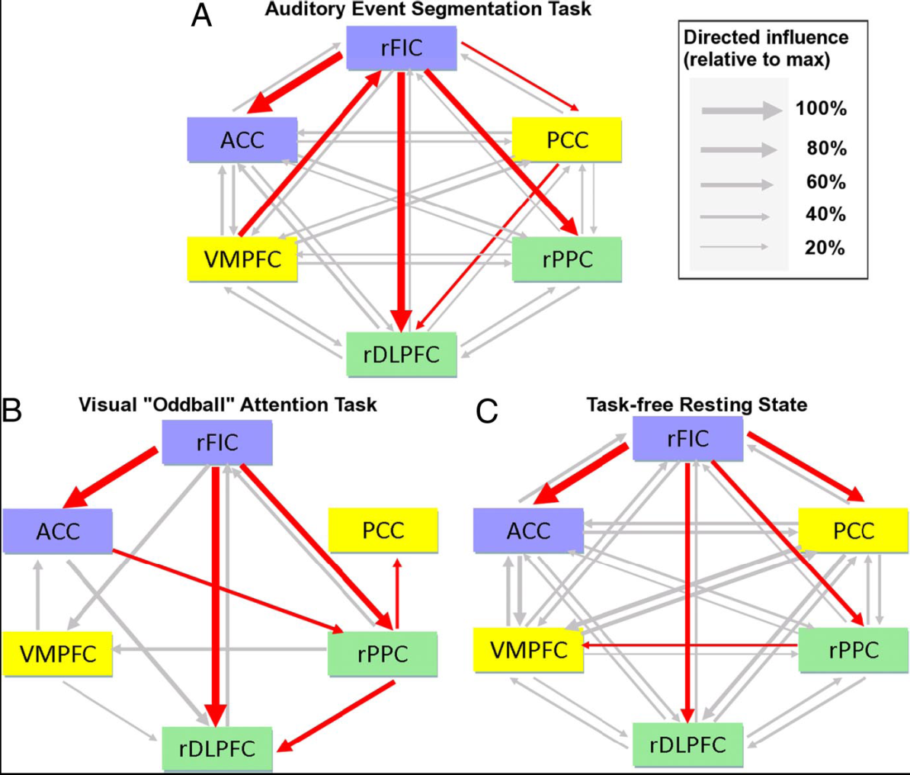
Computational Methodology
GCA in RS-fMRI
Sridharan et al., 2008. PNAS
21

Slide 22
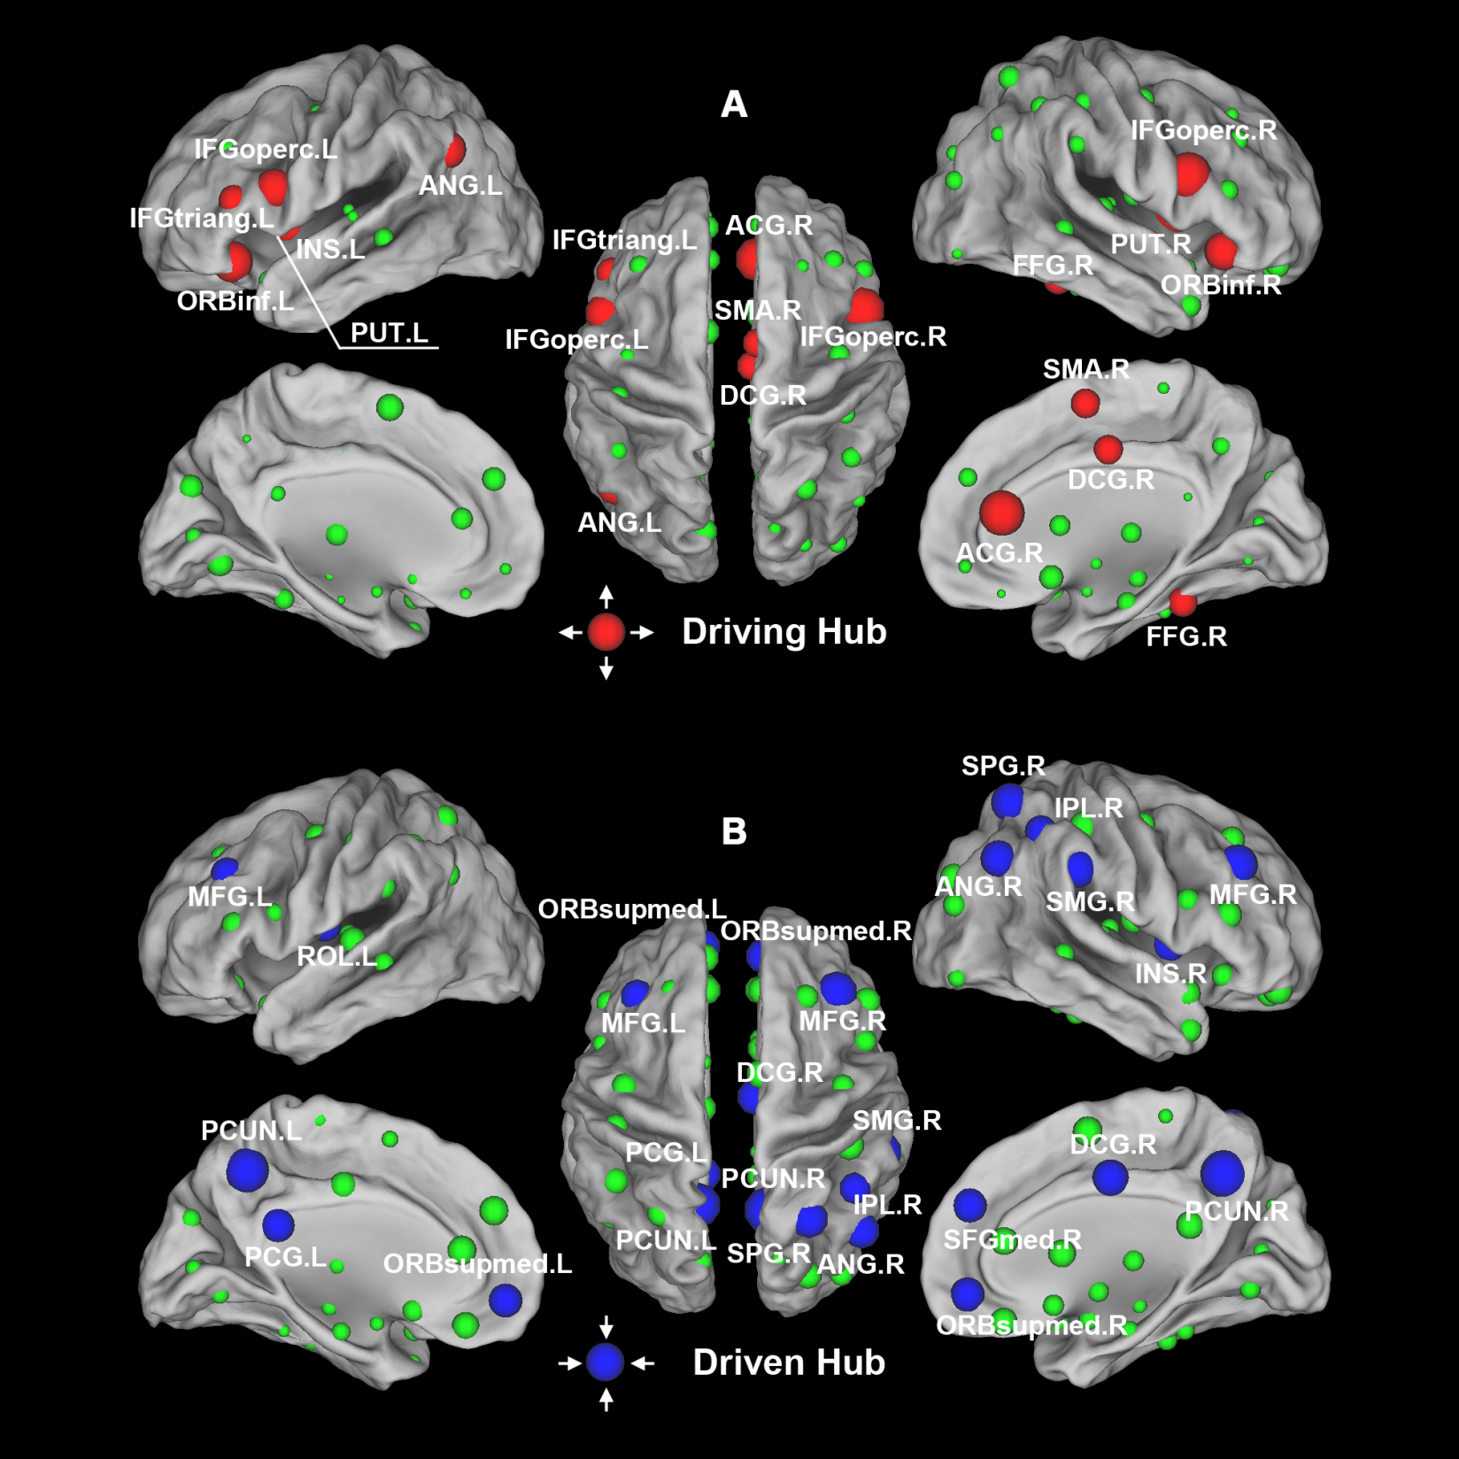
Computational Methodology
GCA in RS-fMRI
Yan et al., 2011.
PLoS ONE
22

Slide 23
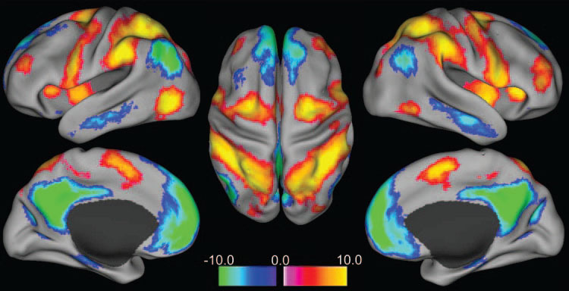
Results and discussion
Fox et al.,
2005.
PNAS
23

Slide 24
Results and discussion
Fox et al.,
2005.
PNAS
24

Slide 25
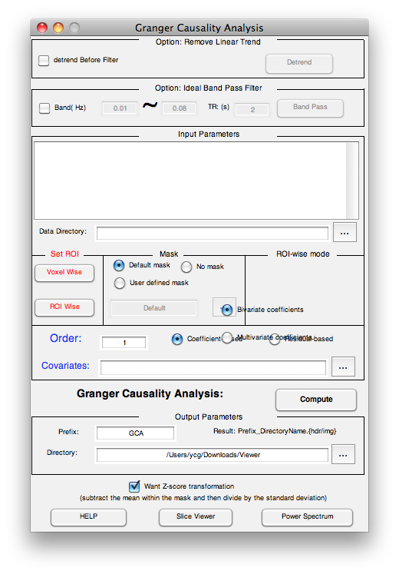
Computational Methodology
GCA
Zang, Yan et al., 2012.
J Neurosci Methods
25

Slide 26
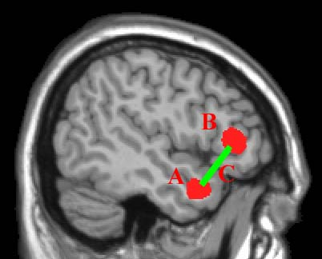
Computational Methodology
Regional approach
“Integrative” is really good, but:
Decreased
functional connectivity
Question: Is A, B, C, or……abnormal?

Slide 27
Computational Methodology
Regional approach
Regional Homogeneity: (Zang et al., 2004)
ALFF, rms, power spectrum: (Biswal et al., 1995; Li et al., 2000; Kiviniemi et al., 2000; Zang et al., 2007)
Fractial ALFF (Zou et al., 2008)
TCA: (Liu et al., 2000; Morgan et al., 2004)
Multiple Regressors: (Fransson, 2005)
Autoregressive Noise Model: (Cordes et al., 2005)
Fractional Gaussian Noise: (Maxim et al., 2005)
…

Slide 28
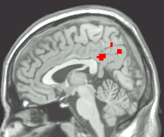
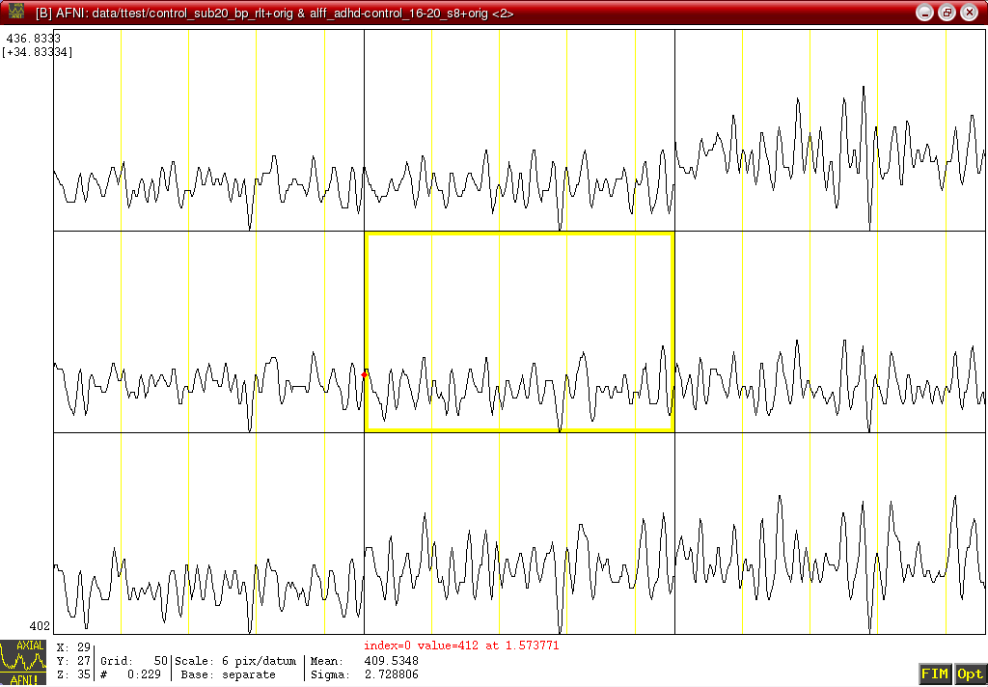
Regional Homogeneity (ReHo)
Computational Methodology
Similarity or coherence of the time courses within a functional cluster
(Zang et al., 2004)

Slide 29
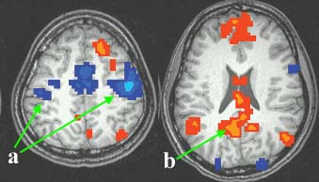
ReHo: motor task state vs. pure resting state
Computational Methodology
Rest > Motor
Motor > Rest
a) Higher ReHo in bilateral primary motor cortices during motor task
b) Higher ReHo in default mode network (PCC, MPFC, IPL) during rest (Raichle et al., 2001; Greicius et al., 2003)
(Zang et al., 2004)

Slide 30
rms, power, ALFF
Computational Methodology
For a given frequency:
root mean square (rms)
standard deviation
amplitude
rms: white matter vs. gray matter = 0.6 : 1
(Biswal et al., 1995; Li et al., 2000)
Square root of the power

Slide 31
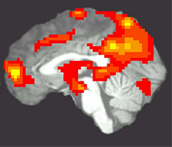
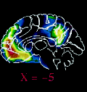
ALFF
Computational Methodology
PET
(Raichle et al., 2001)
ALFF
(Zang et al., 2007)
noise

Slide 32
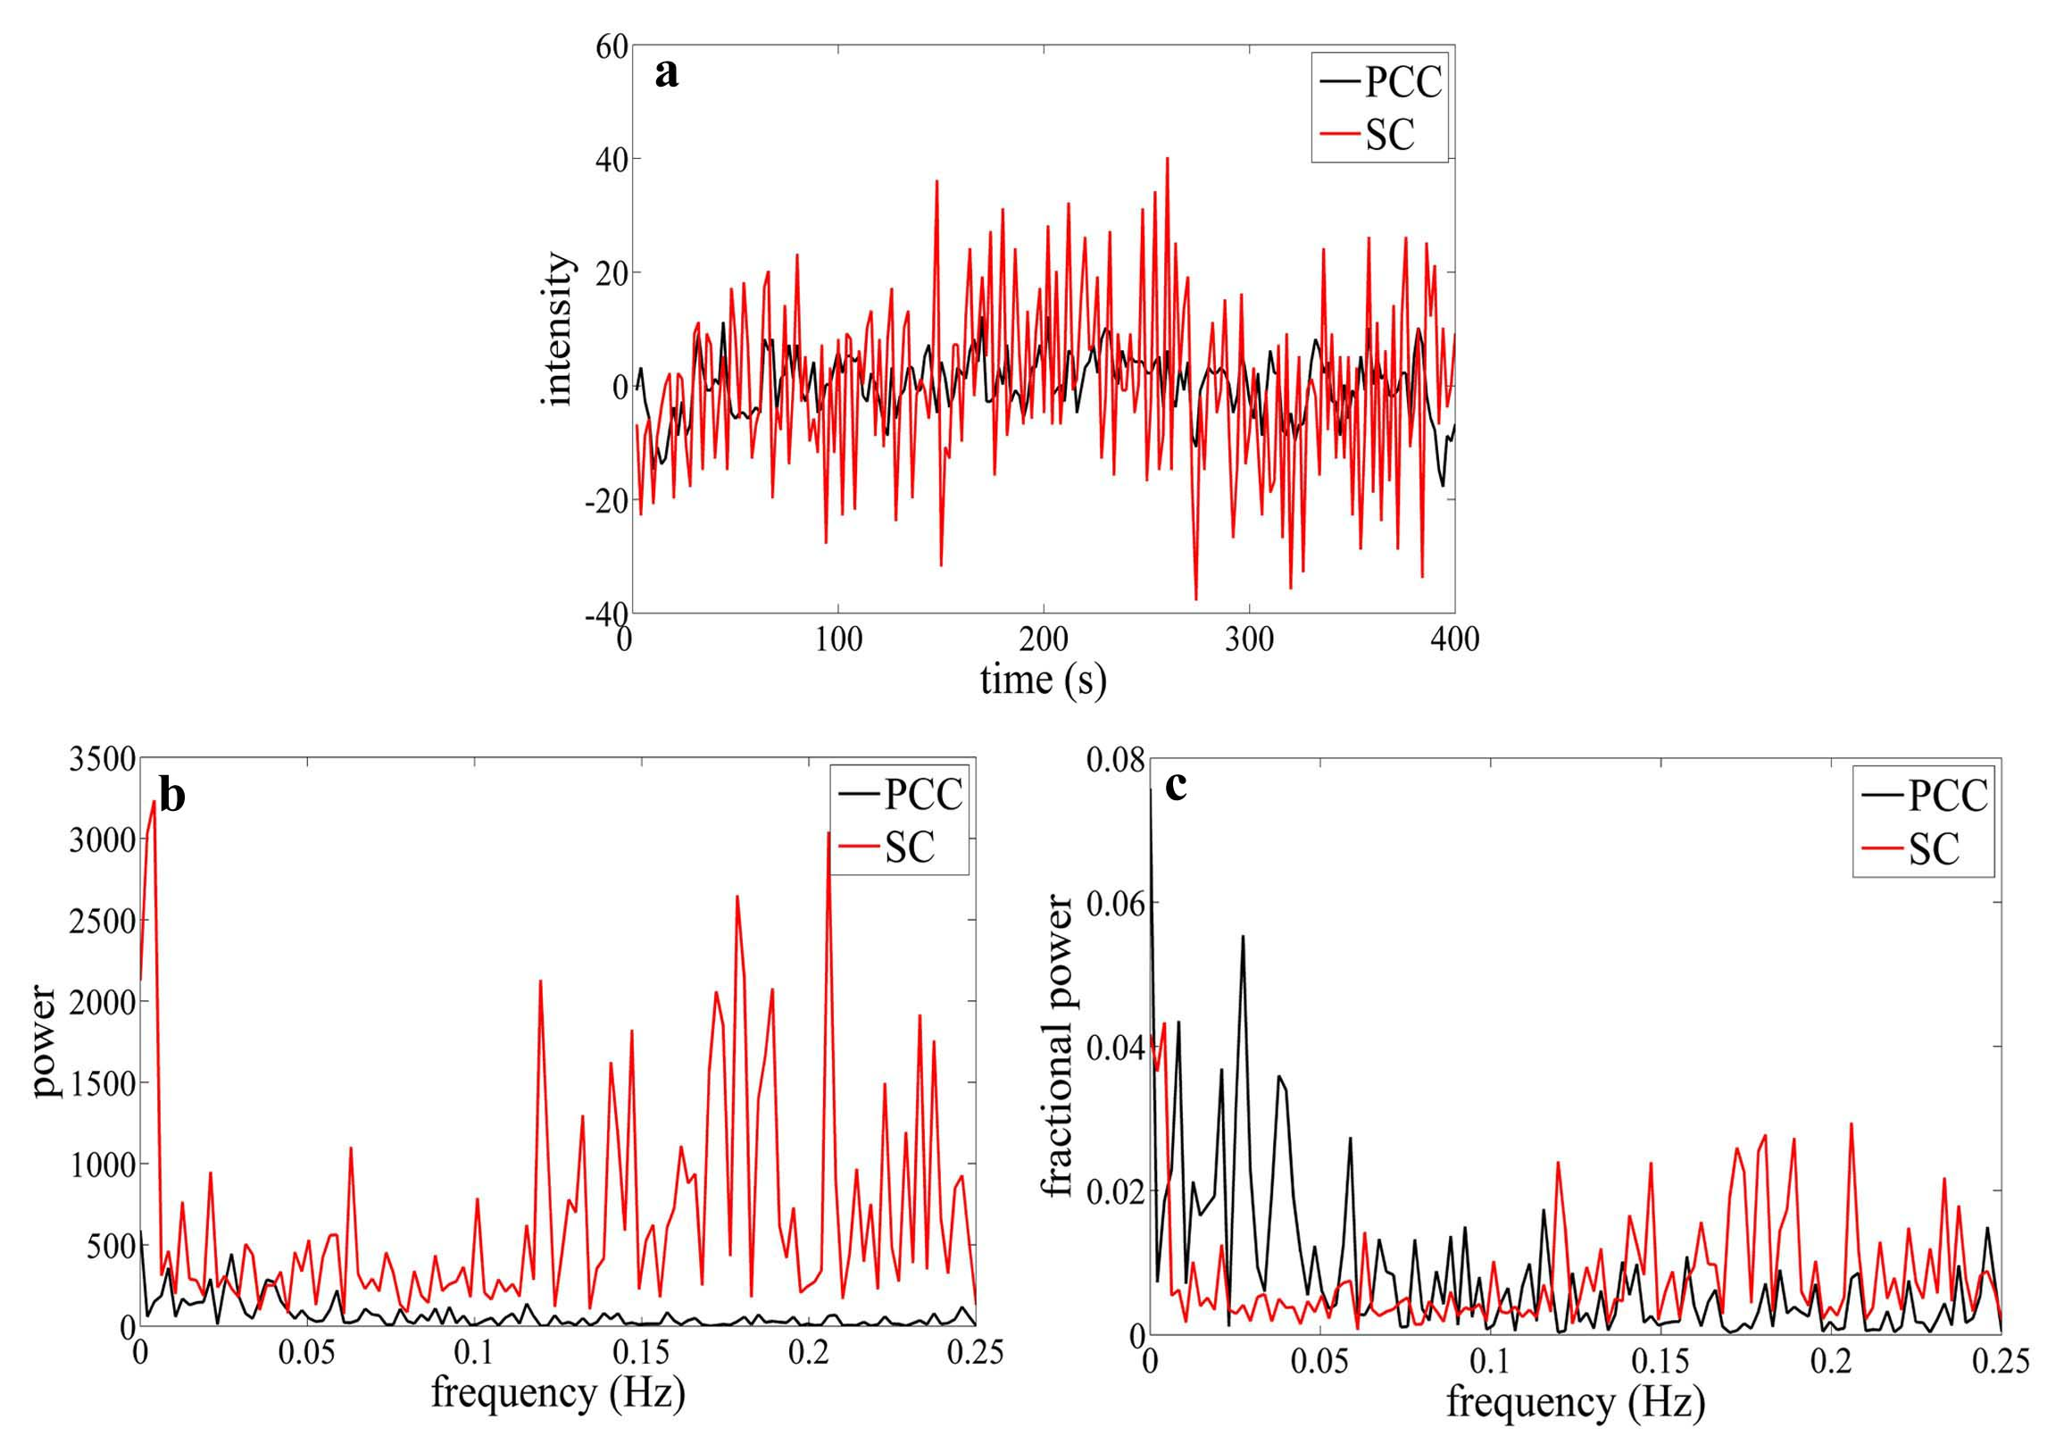
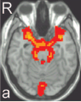
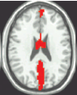
Improvement: fractional ALFF
Computational Methodology
Suprasellar cistern
PCC
Zou et al., 2008. J Neurosci Methods
Notes:
ADHD13例，正常对照儿童12例。静息态fMRI低频（0.01－0.08Hz）振幅（amplitude of low frequency fluctuation, ALFF）可能反映了自发脑活动的强度。SC:鞍上池

Slide 33
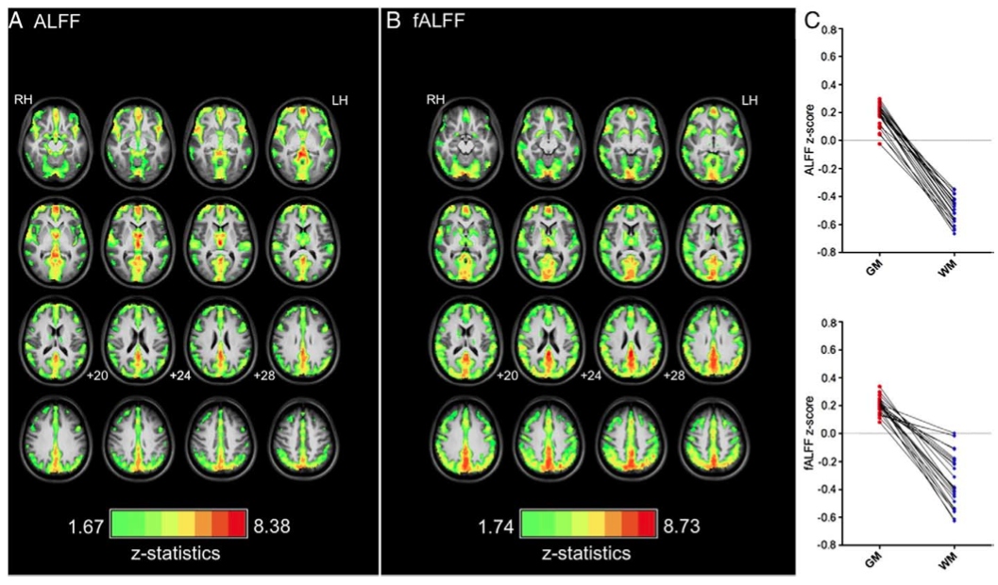
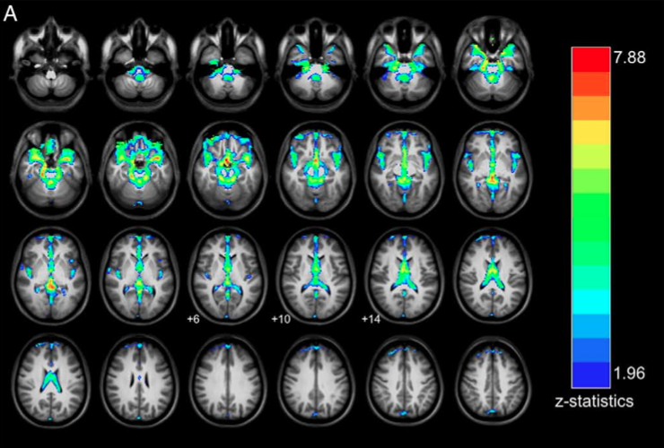
Computational Methodology
Zuo et al., 2010. Neuroimage
Notes:
ADHD13例，正常对照儿童12例。静息态fMRI低频（0.01－0.08Hz）振幅（amplitude of low frequency fluctuation, ALFF）可能反映了自发脑活动的强度。

Slide 34
Computational Methodology
Graphical approach
Graph theoretical analysis: (Salvador et al., 2005, Bullmore and Sporns, 2009)
Degree connectivity, functional connectivity density, degree centrality: (Buckner et al., 2009; Tomasi et al., 2010; Cole et al., 2010; Zuo et al., 2012)
…

Slide 35
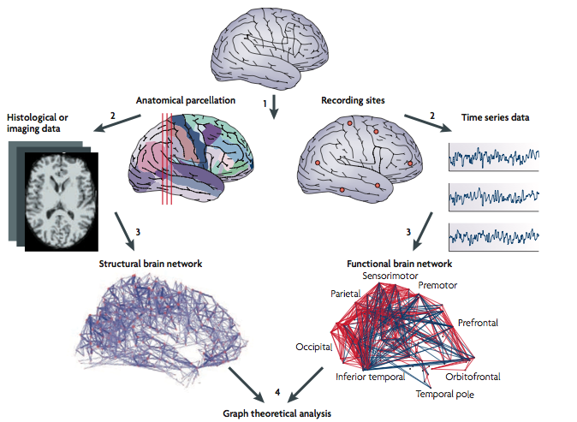
Computational Methodology
Graph theoretical analysis
Bullmore and Sporns, 2009

Slide 36
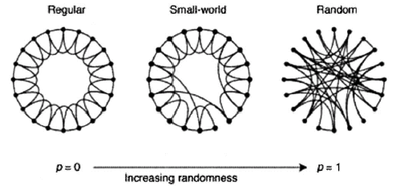
Computational Methodology
Graph theoretical analysis
Node: brain region
Link: connection
Watts and Strogatz, 1998. Nature
Regular:
high Cp
high Lp
Small-world:
high Cp
low Lp
Random:
low Cp
low Lp
Small-world networks contain many local links and a few long-distance links (so-called “shortcuts”).
Cp: average clustering of a network
Lp: average shortest path length of a network
36

Slide 37
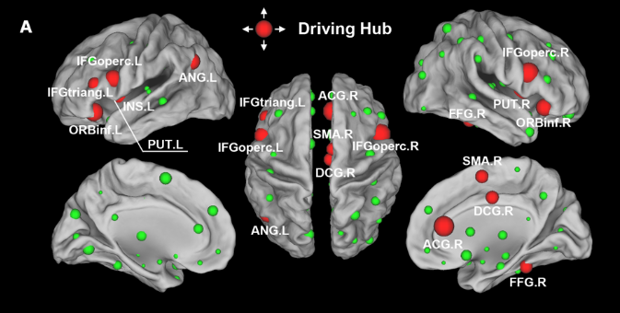
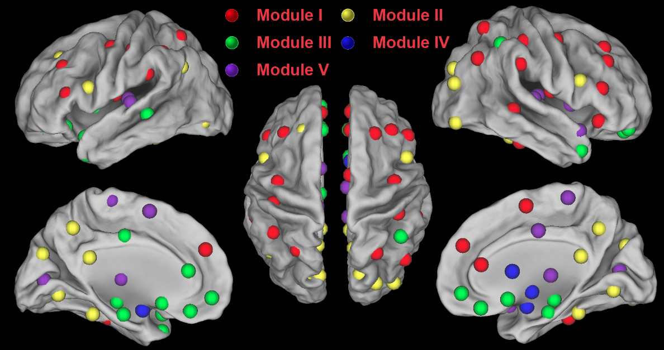
Computational Methodology
Graph theoretical analysis
Hub
Module

Slide 38
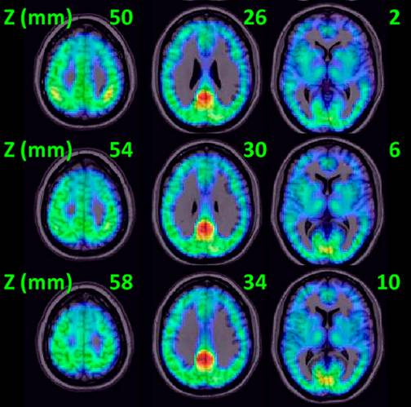
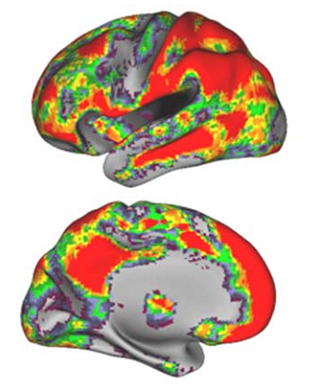
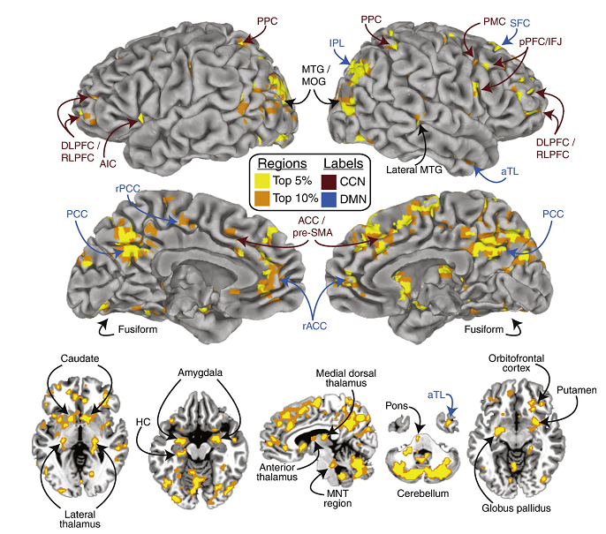
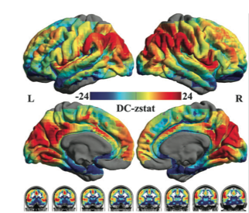
Computational Methodology
Degree centrality
Buckner et al., 2009. J Neurosci
Tomasi et al., 2010. PNAS
Cole et al., 2010. Neuroimage
Zuo et al., 2011. Cereb Cortex

Slide 39
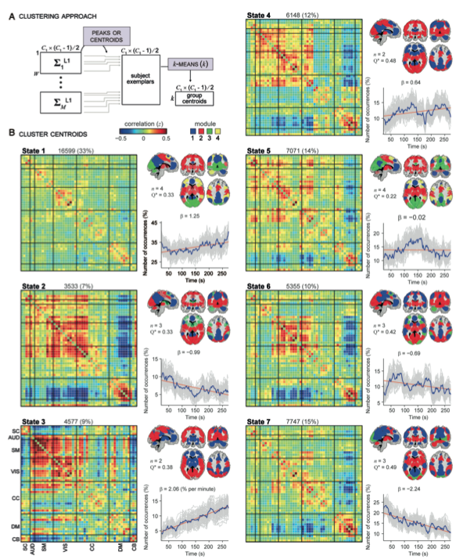
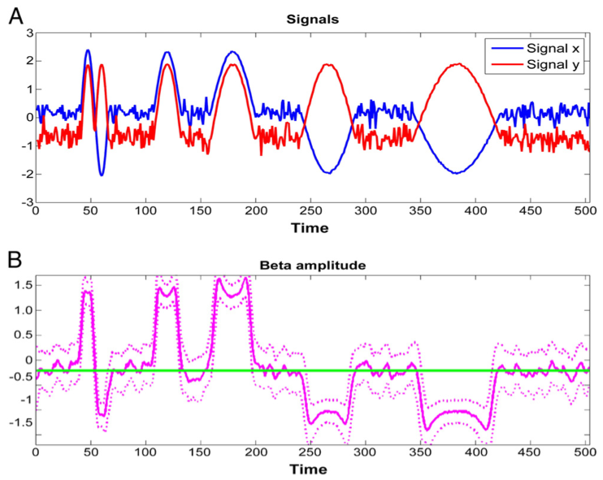
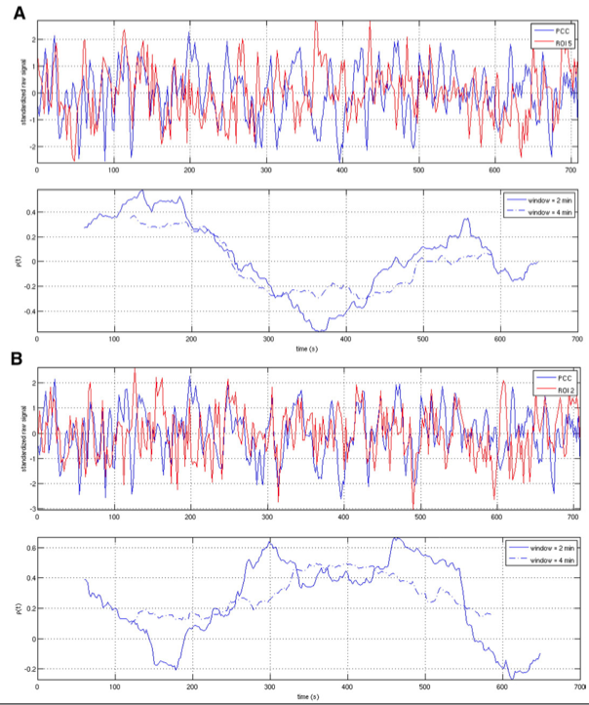
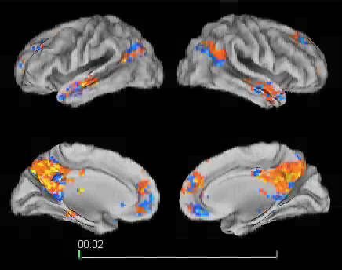
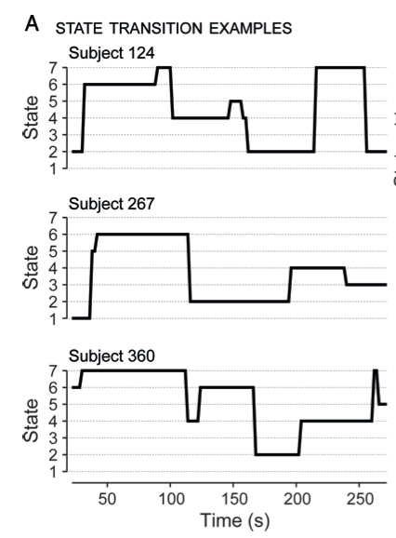
Computational Methodology
Dynamic perspective
Chang and Glover, 2010.
Neuroimage
Kang, , Yan et al., 2011.
Neuroimage
Allen et al., 2013.
Cereb Cortex

Slide 40
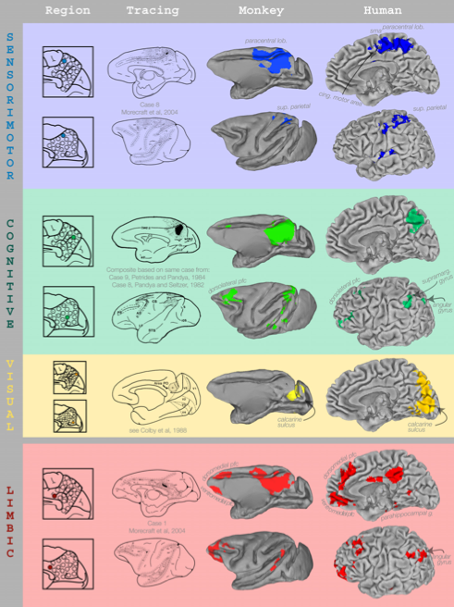
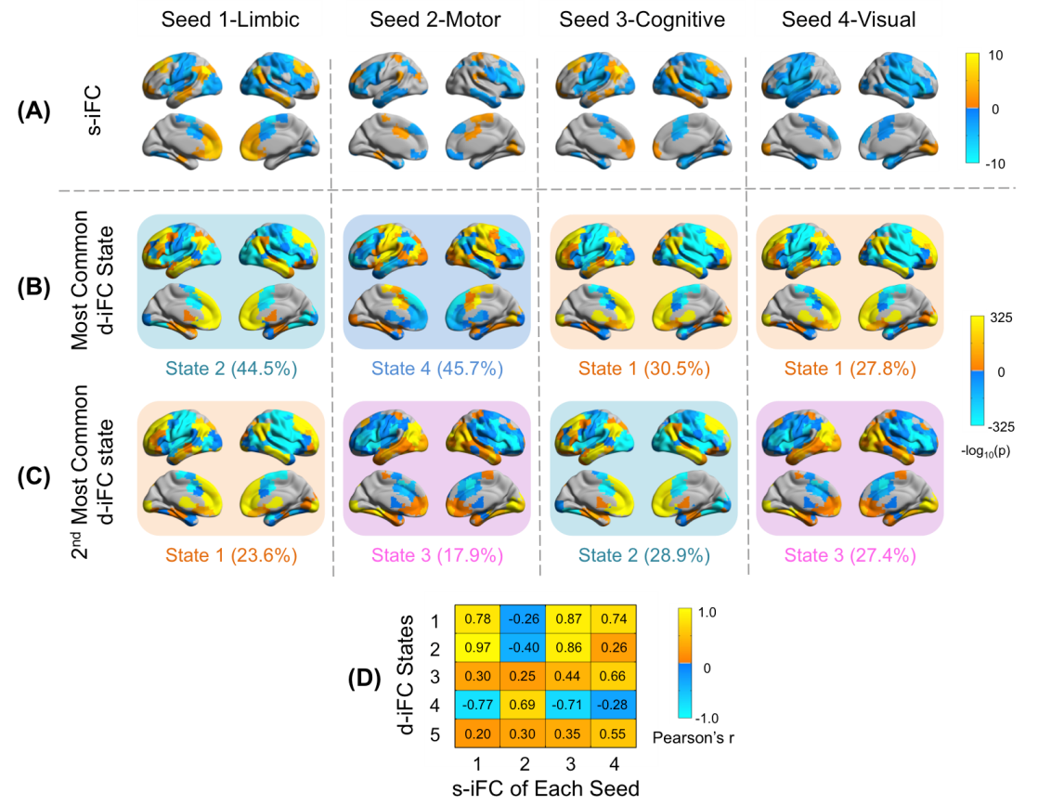
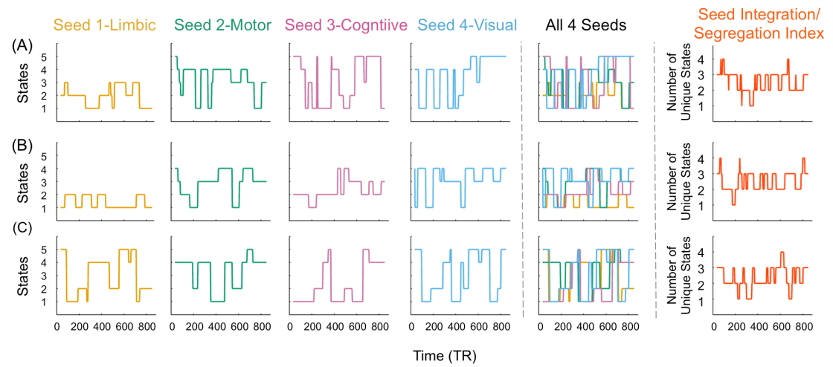
Computational Methodology
Dynamic perspective
Margulies et al., 2009. PNAS
Yang, , Yan, Milham, in submission.

Slide 41
Outline
Resting-State fMRI: Principles
Computational Algorithms
Methodological Issues
Applications to Brain Disorders
Introduction to DPARSF
41

Slide 42
Methodological Issues
Experiment settings
Head motion
Linear trend
Global signal regression
Standardization
And many many more…

Slide 43

Different resting conditions?
Methodological Issues
The functional connectivity patterns of the default mode network was minimally disturbed during different resting conditions with limited cognitive demand (Greicius et al., 2003; Fransson, 2005; Fox et al., 2005)
Fox et al., 2005. PNAS

Slide 44

Different resting conditions?
Methodological Issues
Functional connectivity maps
Significantly different between different resting conditions with limited cognitive demand
Yan et al., 2009. PLoS ONE

Slide 45

Different resting conditions?
Methodological Issues
Regional activity (ALFF)
Yan et al., 2009. PLoS ONE

Slide 46

Different resting conditions?
Methodological Issues
Functional connectivity strength
Functional connectivity strength was significantly diminished for eyes closed rest (ECR) when compared with the fixation (fix)
Van Dijk et al., 2010. J Neurophysiol

Slide 47


Different resting conditions?
Methodological Issues
Patriat et al., 2013. Neuroimage

Slide 48

Order of resting-state conditions?
Methodological Issues
First EC
-
Second EC
Yan et al., 2009. PLoS ONE

Slide 49
Order of resting-state conditions?
Methodological Issues
Scanning sessions (3T Siemens):
S1 Resting-state (Rest1) 8 min
S2 Pictures (indoor or outdoor) (encoding) 5 min
S3 3D structure 8 min
S4 Resting-state (Rest2) 8 min
S5 Retrieval: old or new (2 runs) 10 min
Rest2/Rest1: spontaneous brain activity modulation by task
Wang, , Yan et al., 2012. PLoS ONE

Slide 50

Order of resting-state conditions?
Methodological Issues
Wang, , Yan et al., 2012. PLoS ONE

Slide 51
Methodological Issues
Experiment settings
Make resting-state condition consistent: e.g., fixation (depends on the cooperation of participants).
Make resting-state session before task sessions, unless intended.

Slide 52



Head motion matters
Methodological Issues
Van Dijk et al, 2012. Neuroimage
Power et al, 2012. Neuroimage
Satterthwaite et al., 2012. Neuroimage

Slide 53

Head motion matters
Methodological Issues
Yan et al., 2013. Neuroimage

Slide 54

Head motion matters
Methodological Issues
Yan et al., 2013. Neuroimage

Slide 55

Head motion matters
Methodological Issues
Yan et al., 2013. Neuroimage

Slide 56


Head motion matters
Methodological Issues
Yan et al., 2013. Neuroimage

Slide 57

Methodological Issues
Head Motion
Yan et al., 2013. Neuroimage

Slide 58

Linear Trend
Methodological Issues
Wang, , Yan*, Zang*, in prep.

Slide 59

Linear Trend
Methodological Issues
Wang, , Yan*, Zang*, in prep.

Slide 60




Linear Trend
Methodological Issues
Time
Frequency
Filtering + Detrend
Wang, , Yan*, Zang*, in prep.
Time
Frequency

Slide 61


Linear Trend
Methodological Issues
Time
Frequency
Detrend + Filtering
Wang, , Yan*, Zang*, in prep.
Time
Frequency

Slide 62
Methodological Issues
Linear trend
Linear trend might be meaningful.
Remove linear trend before filtering.

Slide 63





Global Signal Regression
Methodological Issues
Murphy et al., 2009. Neuroimage
Fox et al., 2009. J Neurophysiol

Slide 64

Global Signal Regression
Methodological Issues
Yan et al., 2013. Neuroimage

Slide 65

Global Signal Regression
Methodological Issues
Saad et al., 2013. Brain Connect

Slide 66

Global Signal Regression
Methodological Issues
Yan et al., in submission.

Slide 67



Global Signal Regression
Methodological Issues
Yan et al., 2013. Neuroimage
Motion effect Age effect

Slide 68

Global Signal Regression
Methodological Issues
Saad et al., 2013. Brain Connect

Slide 69
Methodological Issues
Global Signal Regression
Still hot controversial yet!!
No GSR + group-level mean regression (see next section also).
Check GSR as complimentary analysis if is interested in.
More GSR mechanism studies needed!

Slide 70



Standardization
Methodological Issues
Yan et al., 2013. Neuroimage

Slide 71
Standardization
Methodological Issues
Yan et al., 2013. Neuroimage

Slide 72


Standardization
Methodological Issues
Yan et al., 2013. Neuroimage

Slide 73

Standardization
Methodological Issues
Yan et al., 2013. Neuroimage

Slide 74

Standardization
Methodological Issues
Yan et al., 2013. Neuroimage

Slide 75

Standardization
Methodological Issues
Yan et al., 2013. Neuroimage

Slide 76

Standardization
Methodological Issues
Yan et al., 2013. Neuroimage

Slide 77

Standardization
Methodological Issues
Yan et al., 2013. Neuroimage

Slide 78

Standardization
Methodological Issues
Yan et al., 2013. Neuroimage

Slide 79
Methodological Issues
Standardization
Mean regression-based approach.
Mean regression + SD division (for controlling mulplicative effects).

Slide 80
Outline
Resting-State fMRI: Principles
Computational Algorithms
Methodological Issues
Applications to Brain Disorders
Introduction to DPARSF
80

Slide 81
Applications to Brain Disorders
Alzheimer's Dementia (AD)
Preoperative (Tumor)
…

Slide 82
Applications to Brain Disorders
Functional connectivity (correlation) in AD

Slide 83
Applications to Brain Disorders
Functional connectivity (correlation) in AD
AD: decreased connectivity with the right hippocampus
(Wang et al., 2006)

Slide 84

Applications to Brain Disorders
Functional connectivity (ICA) in AD
“Goodness-of-fit”
Increased functional connectivity in normal elderly
(Greicius et al., 2004)

Slide 85
Applications to Brain Disorders
ReHo in AD

Slide 86




Applications to Brain Disorders
ReHo in AD
(He et al., 2007)
Consistent with PET studies (Reiman et al., 1996; Minoshima et al., 1994)

Slide 87
Applications to Brain Disorders
ALFF in AD

Slide 88



Applications to Brain Disorders
ALFF in AD
Wang*, Yan* et al., 2011, Hum Brain Mapp
Notes:
a sensitivity of 81% and a specificity of 73%.

Slide 89

Applications to Brain Disorders
Degree centrality in AD
Dai, Yan et al., in prep.

Slide 90

Applications to Brain Disorders
Degree centrality in AD
Dai, Yan et al., in prep.

Slide 91

Applications to Brain Disorders
Classification in AD
Multi-modal imaging and multi-level characterization with multi-classifier (M3)
Features
ALFF
ReHo
Regional correlation strength
Gray matter density
Accuracy: 89.47%
Dai*, Yan* et al., 2012, NeuroImage

Slide 92
Applications to Brain Disorders
Functional connectivity in Preoperative (Tumor)

Slide 93


Applications to Brain Disorders
Functional connecitivty in Preoperative (Tumor)
Case 1
Case 2
Zhang et al., 2009. Neurosurgery

Slide 94






Direct Cortical Stimulation
Applications to Brain Disorders
Functional connectivity in Preoperative (Tumor)
R
L
L
R
Motor task fMRI (top 2%)
Illustrative Case 16
Qiu, , Yan et al., in prep.
R-fMRI iFC of hand area (top 2%)

Slide 95


Applications to Brain Disorders
H: hand M: mouth
Qiu, , Yan et al., in prep.

Slide 96








Applications to Brain Disorders
L: leg; H: hand; M: mouth;
1, 2, 3: speech arrest; 5, 6: picture naming
Post-op
muscle strength: V
Illustrative Case 13: CANNOT perform motor fMRI task
Qiu, , Yan et al., in prep.

Slide 97
Applications to Brain Disorders
No | Age | Sex | Lesion locate | real positive | real negative | false positive | false negative
1 | 41 | M | Left frontal | 2 | 24 | 4 | 0
2 | 23 | M | Left frontal | 2 | 37 | 2 | 0
3 | 38 | M | Left frontal | 2 | 33 | 4 | 0
4 | 27 | M | Left parietal | 1 | 39 | 8 | 0
5 | 51 | F | Left frontal | 2 | 8 | 4 | 0
6 | 36 | F | Left frontal | 1 | 25 | 8 | 0
7 | 67 | F | Left frontal | 2 | 6 | 4 | 0
8* | 49 | M | right parietal
9 | 39 | M | Left frontal | 1 | 33 | 6 | 0
10 | 40 | M | Left frontal | 2 | 34 | 2 | 1
11 | 49 | M | Left frontal | 1 | 40 | 3 | 2
12 | 45 | F | right frontal | 0 | 35 | 7 | 1
13* | 32 | M | Left frontal
14 | 39 | F | right frontal | 2 | 28 | 2 | 0
15 | 50 | M | Left frontal | 2 | 18 | 9 | 0
16 | 23 | M | Left frontal | 1 | 36 | 9 | 0
17 | 34 | F | Left frontal | 1 | 23 | 2 | 1
total |  |  |  | 22 | 419 | 74 | 5
Sensitivity / Specificity |  |  |  | 78.57% / 84.76%
Motor task
No | Age | Sex | Lesion locate | real positive | real negative | fault positive | fault negative
1 | 41 | M | Left frontal | 4 | 26 | 0 | 0
2 | 23 | M | Left frontal | 2 | 36 | 3 | 0
3 | 38 | M | Left frontal | 3 | 33 | 3 | 0
4 | 27 | M | Left parietal | 1 | 41 | 6 | 0
5 | 51 | F | Left frontal | 2 | 8 | 4 | 0
6 | 36 | F | Left frontal | 1 | 25 | 8 | 0
7 | 67 | F | Left frontal | 0 | 9 | 1 | 2
8 | 49 | M | right parietal | 1 | 32 | 2 | 0
9 | 39 | M | Left frontal | 1 | 38 | 1 | 0
10 | 40 | M | Left frontal | 3 | 34 | 2 | 0
11 | 49 | M | Left frontal | 2 | 36 | 7 | 1
12 | 45 | F | right frontal | 1 | 36 | 6 | 0
13 | 32 | M | Left frontal | 4 | 48 | 2 | 0
14 | 39 | F | right frontal | 2 | 24 | 6 | 0
15 | 50 | M | Left frontal | 2 | 26 | 1 | 0
16 | 23 | M | Left frontal | 1 | 38 | 7 | 0
17 | 34 | F | Left frontal | 2 | 25 | 0 | 0
total |  |  |  | 32 | 515 | 59 | 3
Sensitivity / Specificity |  |  |  | 90.91% / 89.41%
R-fMRI
Qiu, , Yan et al., in prep.

Slide 98




Sensitive
Applications to Brain Disorders
Autism
ADHD
Di Martino, Yan et al., 2013. Mol Psychiatry
Zhu, , Yan et al., 2008. Neuroimage
OCD
Deaf
Zhang, , Yan et al., 2011. J Psychiatry Neurosci
Li, , Yan et al., 2013. Cereb Cortex

Slide 99




Reliable
Applications to Brain Disorders
Shehzad et al., 2009. Cereb Cortex
Zuo et al., 2010. Neuroimage
Zuo et al., 2012. Cereb Cortex
Yan et al., 2013. Neuroimage

Slide 100
Outline
Resting-State fMRI: Principles
Computational Algorithms
Methodological Issues
Applications to Brain Disorders
Introduction to DPARSF
100

Slide 101

DPARSF
Yan and Zang, 2010.
Front Syst Neurosci.
http://rfmri.org/DPARSF
Based on Matlab, SPM, REST, MRIcroN’s dcm2nii

Slide 102

DPARSF
Yan C, Zang Y. 2010. DPARSF: A MATLAB Toolbox for "Pipeline" Data Analysis of Resting-State fMRI. Front Syst Neurosci. 4: 13.

Slide 103
Demo Data
ProcessingDemoData.zip
FunRaw
Sub_001
Sub_002
Sub_003
T1Raw
Sub_001
Sub_002
Sub_003
Functional DICOM data
Structural DICOM data
http://rfmri.org/DemoData

Slide 104

DPARSF
Template Parameters
104

Slide 106
DPARSF
Reorient Interactively
This step could improve the accuracy in coregistration, segmentation and normalization, especially when images had a bad initial orientation.
Also can take as a QC step.

Slide 107

107

Slide 108

108

Slide 109

Display the mean image after realignment. (Could take this step as a QC procedure.)
109

Slide 110
DPARSF
Functional Connectivity (voxel-wise seed based correlation analysis)
Extract ROI time courses (also for ROI-wise Functional Connectivity)
Define ROI
110

Slide 111

Define ROI
111

Slide 112
112

Slide 113
DPARSF
Parallel Workers (if parallel computing toolbox is installed)
Each subject is distributed into a different worker. (Except DARTEL-Create Template)
113

Slide 114
DPARSF
Multiple functional sessions
1st session: FunRaw
2nd session: S2_FunRaw
3rd session: S3_FunRaw
…
114

Slide 115
Starting Directory Name
You can start at any step by specifying the Starting Directory Name.
115

Slide 116







Normalize
Check Normalization with DPARSF
{WORKINGDIR}\PicturesForChkNormalization
116

Slide 117


Statistical Analysis in REST

Slide 118
Future Directions
R-fMRI methodology
Mechanism of R-fMRI: electrophysiology/fMRI simultaneous recording
Modulation and intervention: TMS (combined with fMRI)
Application to clinical studies
Notes:
ASL: Arterial spin labeled 动脉自旋标记 CBF;
VASO: Vascular Space Occupancy 血管空间占用 CBV

Slide 119
Future Directions
Multiple Disciplines
Neurology and Psychiatry
Neuroradiology
Cognitive Neuroscience
Computer Science
…
Notes:
ASL: Arterial spin labeled 动脉自旋标记 CBF;
VASO: Vascular Space Occupancy 血管空间占用 CBV

Slide 120
Acknowledgments
Child Mind Institute
Michael P. Milham
R. Cameron Craddock
Zhen Yang
Qingyang Li
Hangzhou Normal University Yu-Feng Zang
Beijing Normal University
Yong He
Nathan Kline Institute
Stan Colcombe
Charles Schroeder
Gary Linn
Mark Klinger
Fudan University
Tian-Ming Qiu
Chinese Academy of Sciences Xi-Nian Zuo
NYU Child Study Center
F. Xavier Castellanos
Adriana Di Martino
Clare Kelly
Columbia University
Tiziano Colibazzi
120
Notes:
Different Axis!!!

Slide 121
Thanks for your attention! More recourses at rfmri.org!
121

